Slide 1
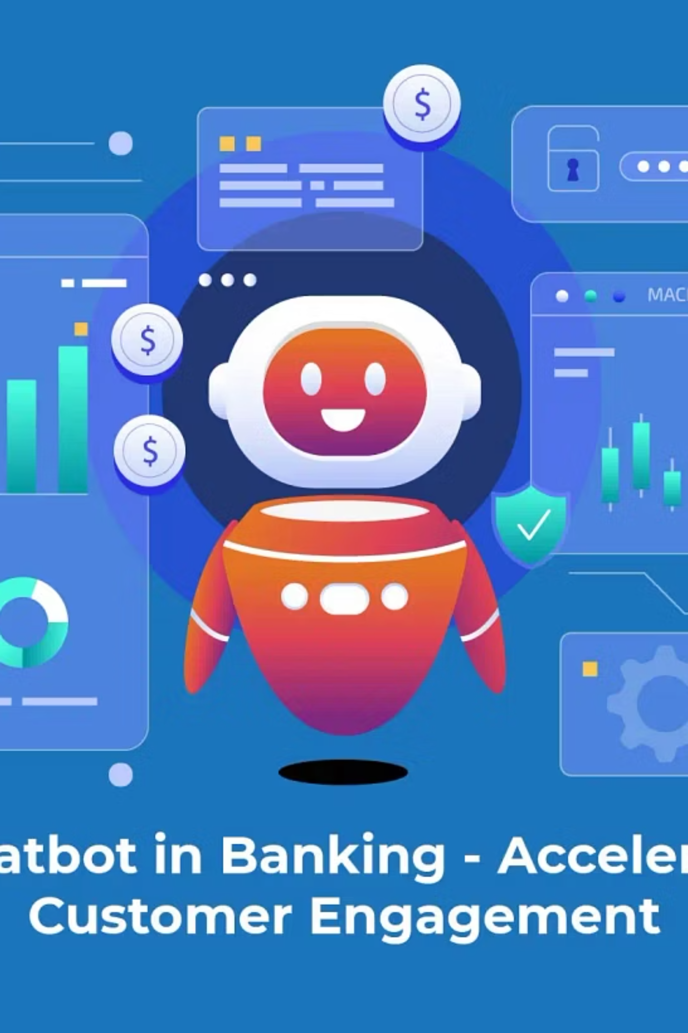
Django–React AI banking system

Slide 2
Problem Statement
Why this system exists
Start with what your paper identified:
Current banking chatbots fail because they treat all queries the same.
They:
Give wrong answers to sensitive queries
Expose customers to risk
Cannot scale human support
Do not understand context or risk
Your paper defines this as the "Fragmented Service Delivery Problem".
Show examples:
Asking for balance → same flow as asking branch hours
Lost card → treated like FAQ
Fraud → not escalated
This motivates your system.

Slide 3






Your Core Innovation
Real-Time Query Stratification & Resource Mapping
This is the heart of your work.
Explain:
"My system classifies every user query in real time across two dimensions: intent and risk, then routes it to the correct resource."
Show the pipeline:
User query
Intent Model (Transformer)
FinBERT Risk Model
Stratification Engine
Resource Router
FAQ / Live API / Secure App / Human
This is directly from your paper.

Slide 4

AI Models Used
Why they are appropriate
You must justify each:
Intent Model
Purpose: Understand what the user wants
Trained on banking-specific intents
FinBERT (Risk Model)
Purpose: Detect financial risk
Trained on financial language → better than generic BERT
Detects:
Distress
Account access
Money loss
Fraud
This supports your paper's claim that financial domain models outperform generic ones.

Slide 5
Knowledge Intelligence Layer
Explain that your system is not keyword-based.
It uses:
Source
Role
Django Admin
Live, controlled knowledge
faqs.csv
Bulk bank knowledge
Sentence-BERT
Semantic search
Live APIs
Real-time data
This implements "Fragmented Knowledge Integration" from your paper.

Slide 6
Risk-Aware Routing
Show the decision matrix:
Risk
Intent
Route
LOW
Info
FAQ / API
MEDIUM
How-to
Guided steps
HIGH
Account
Secure App
Unknown
Any
Escalation
This proves your system enforces banking governance.

Slide 7
Live Banking Capabilities
Demonstrate:
Branch locator
Exchange rates
Agent finder
(live geolocation)
Explain:
"This removes static FAQs and connects the chatbot to real banking infrastructure."
This directly supports your paper's Resource Mapping concept.

Slide 8
Auditability & Compliance
Show Django Admin:
Chat logs
Risk labels
Routes
Timestamps
Explain:
"Every interaction is logged and auditable — this is required for regulated financial systems."
This is a major academic and practical contribution.

Slide 9




Evaluation Framework
Use the test set I gave you.
Explain metrics:
Risk accuracy
Routing accuracy
Safety
Knowledge coverage
(no high-risk answers in public)
Show a few example evaluations.

Slide 10
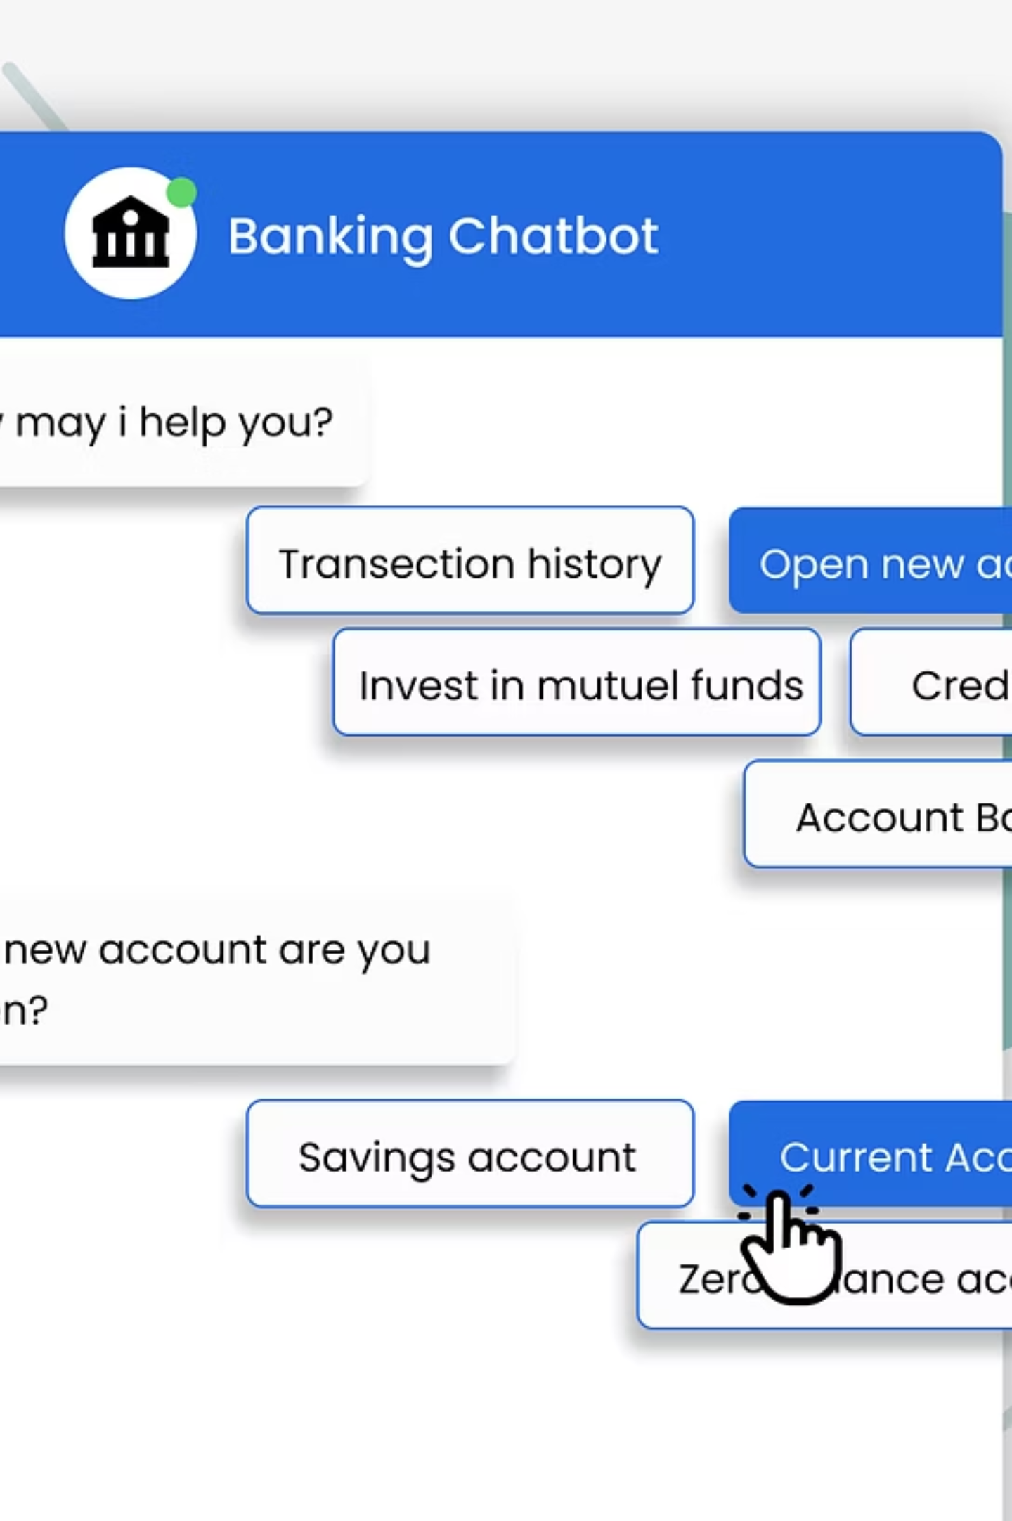
Live Demo
(Most Important)
Demonstrate:
Branch hours
→ answered immediately
Loan requirements
→ guided
"What is my balance?"
→ blocked & secure
"I lost my card"
→ escalated
This proves your theory works.

